Slide 1
PATEL DEV JATINBHAI
DBMS ASSIGNMENT 5
CE076
20CEUOS018

Slide 2
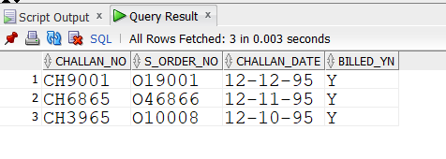
1.Create challan_header table and insert data.

Slide 3
create table Challan_Header (
Challan_no varchar2(6)primary key,
s_order_no varchar2(6),
challan_date date NOT NULL,
billed_yn char(1)default('N'),
check(billed_yn IN('Y','N')),
FOREIGN KEY(s_order_no)REFERENCES sales_order);
desc challan_header;
insert into challan_header values('CH9001','O19001','12-DEC-95','Y');
insert into challan_header values('CH6865','O46866','12-NOV-95','Y');
insert into challan_header values('CH3965','O10008','12-OCT-95','Y');

Slide 4
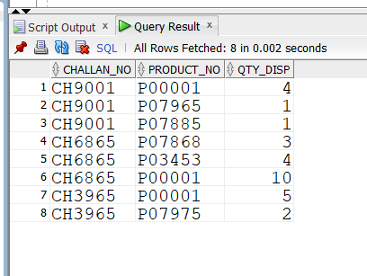
2.Create challan-details table and insert data

Slide 5
create table Challan_Details (
Challan_no varchar2(6),
Product_no varchar2(6),
Qty_disp number(4,2) NOT NULL,
FOREIGN key(Challan_no) references Challan_Header,
FOREIGN key(Product_no) references Product_master
);
desc challan_details;
insert into challan_details values('CH9001','P00001',4);
insert into challan_details values('CH9001','P07965',1);
insert into challan_details values('CH9001','P07885',1);
insert into challan_details values('CH6865','P07868',3);
insert into challan_details values('CH6865','P03453',4);
insert into challan_details values('CH6865','P00001',10);
insert into challan_details values('CH3965','P00001',5);
insert into challan_details values('CH3965','P07975',2);
select * from challan_details;

Slide 6
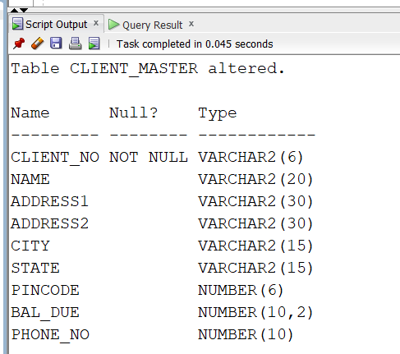
3.1..Add a new column phone_no in the client_master table with datatype number(10).

Slide 7
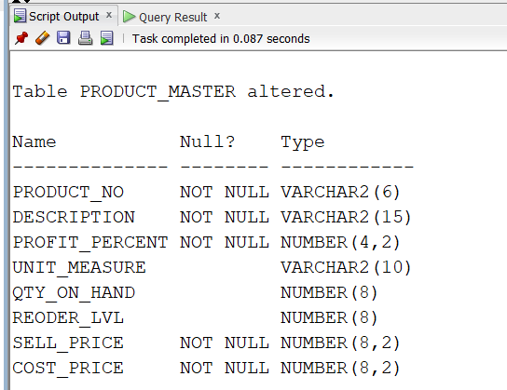
3.2..Add the not null constraint in the product_master table with the columnsdescription, profit percent , sell price and cost price.

Slide 8
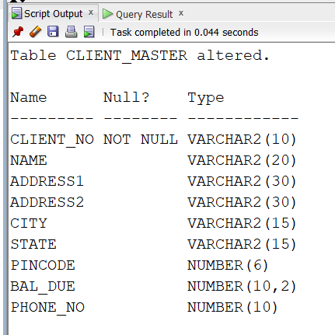
3.3..Change the size of client_no field to 10 in the client_master table.

